Slide 1
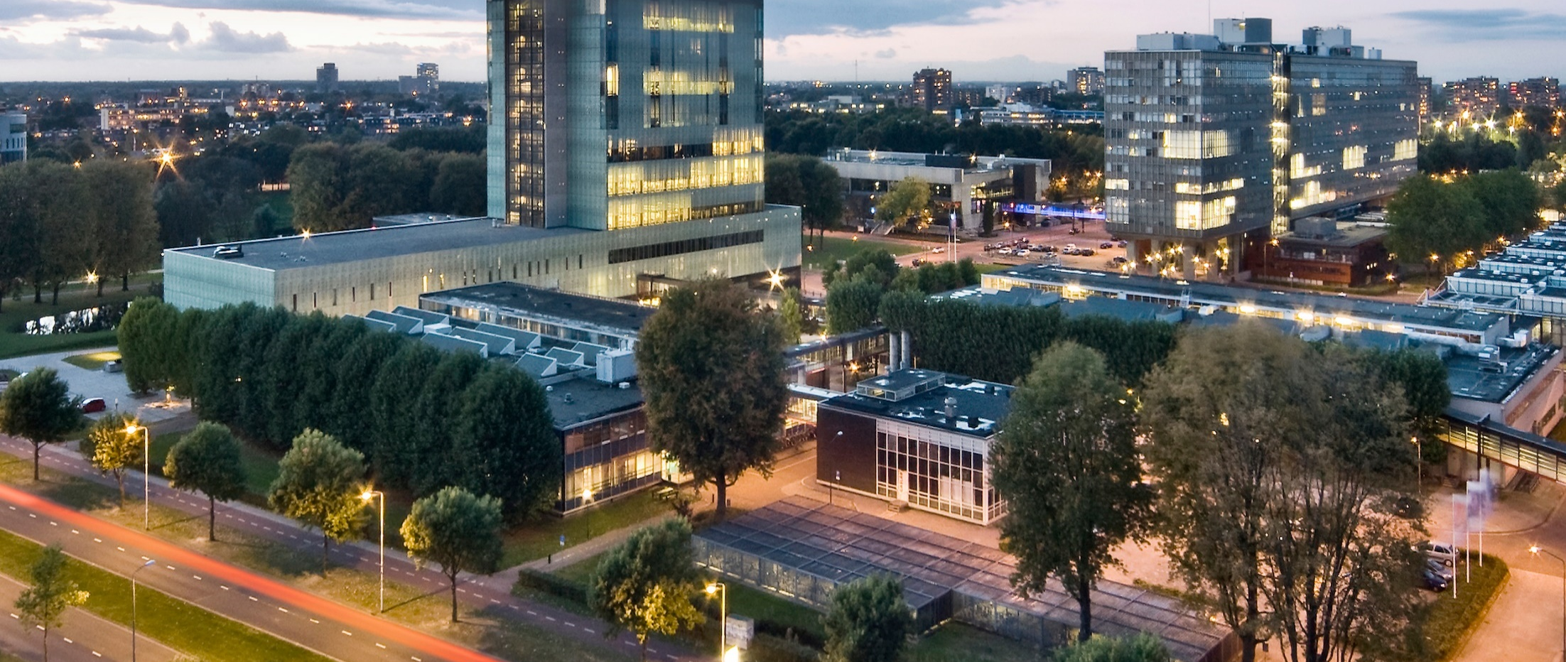

Golden Ratio
DAY4-BÉZIER-CURVES
Prof. dr. ir. Loe Feijs
Department of Industrial Design, TU Eindhoven

Slide 2
Resources
Processing3, please install from
https://processing.org/download/
Github, digital-craftmanship’s repository GOLDEN-RATIO
this powerpoint (.pptx)
bezier.pde
newBezierLab.pde
github.com/digital-craftsmanship/GOLDEN-RATIO/tree/master/DAY4-BEZIER-CURVES
External link
en.wikipedia.org/wiki/Bézier_curve

Slide 3
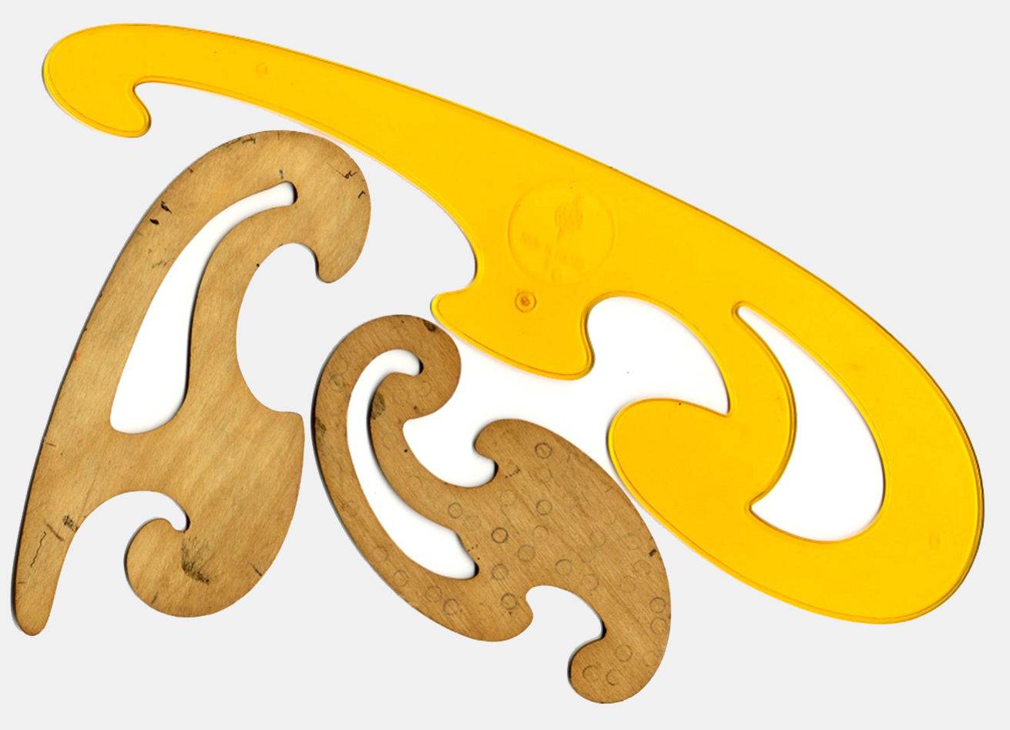

Inspiration
French Curves (actually not Bézier, used in pre-Bézier era)
Source: file Krzywiki.jpg by Radomil, Wikimedia

Slide 4
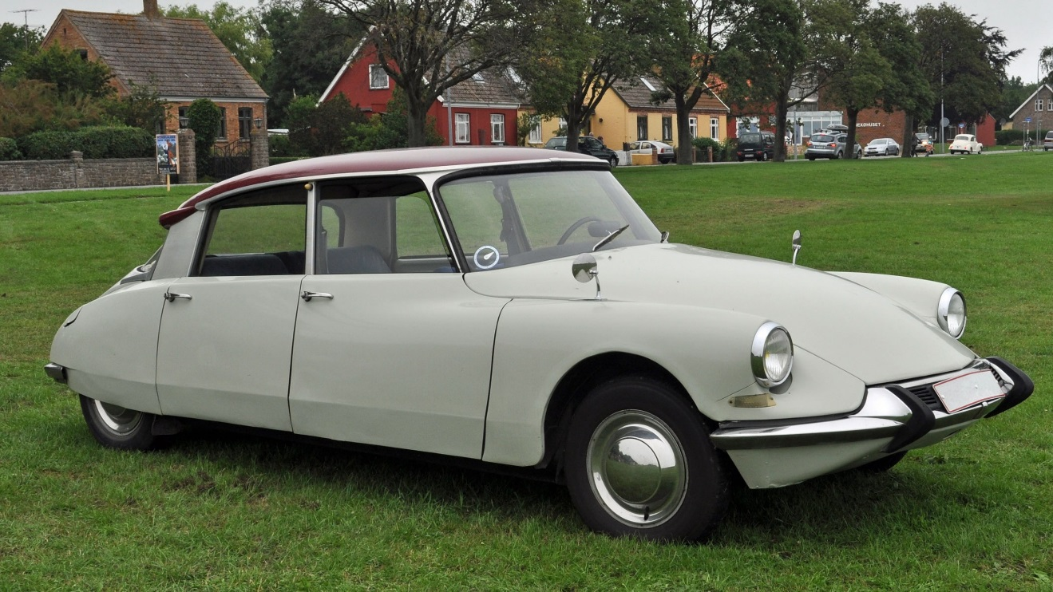
Inspiration
Citroen DS19 (1955-1975)
Image by Klugschnacker, Wikimedia

Slide 5
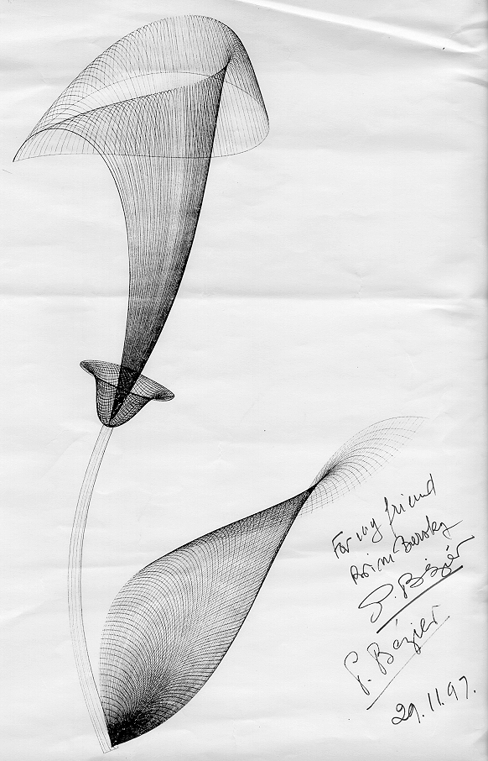
Inspiration
Artwork by Pierre Bézier, 1997
Source:people.eecs.berkeley.edu/~barsky/Gifs/bezier.html

Slide 6
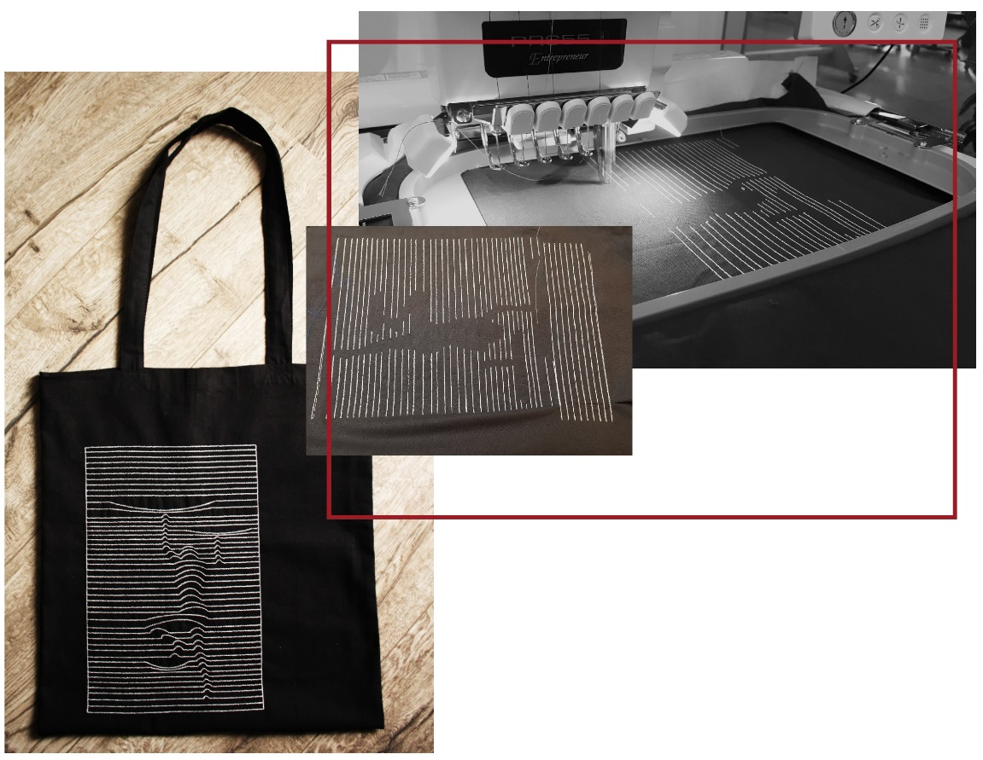
Inspiration
“Oneliners” by Caro van Kessel,
TU/e Master class Golden Ratio and Generative Arts, 2017
Citation: Feijs, L., Hu, J., Funk, M., Goevaerts, M., Keusters, T., & Van Kessel, C. (2017). Constructing Mini-tools for Tessellations. In Bridges 2017 Conference Proceedings (pp. 395-398). Tessellations Publishing.

Slide 7
Today’s lecture:
Bézier curves in “nature”
mathematics of Bézier curves
example: Bézier in Processing
example: dynamic typography

Slide 8
Bézier curves in “nature”
The cars on our roads
All other man-made objects around us
All the letters of the texts on our computers

Slide 9
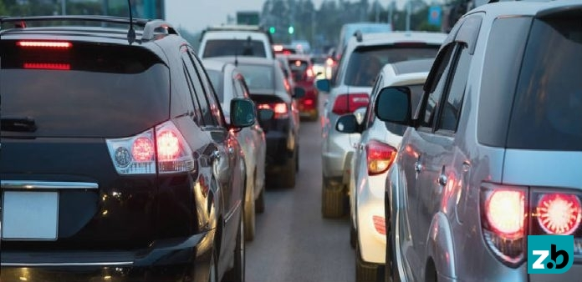
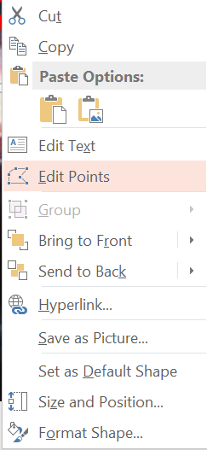
Bézier curves in “nature”
Source: ZakenBlad (20 procent meer files in Nederland, ook op Limburgse wegen neemt filezwaarte toe)

Slide 10

Bézier curves in “nature”
Source: ZakenBlad (20 procent meer files in Nederland, ook op Limburgse wegen neemt filezwaarte toe)

Slide 11

Bézier curves in “nature”

Slide 12

Ellipses in “nature”

Slide 13

Bézier curves in “nature”

Slide 14
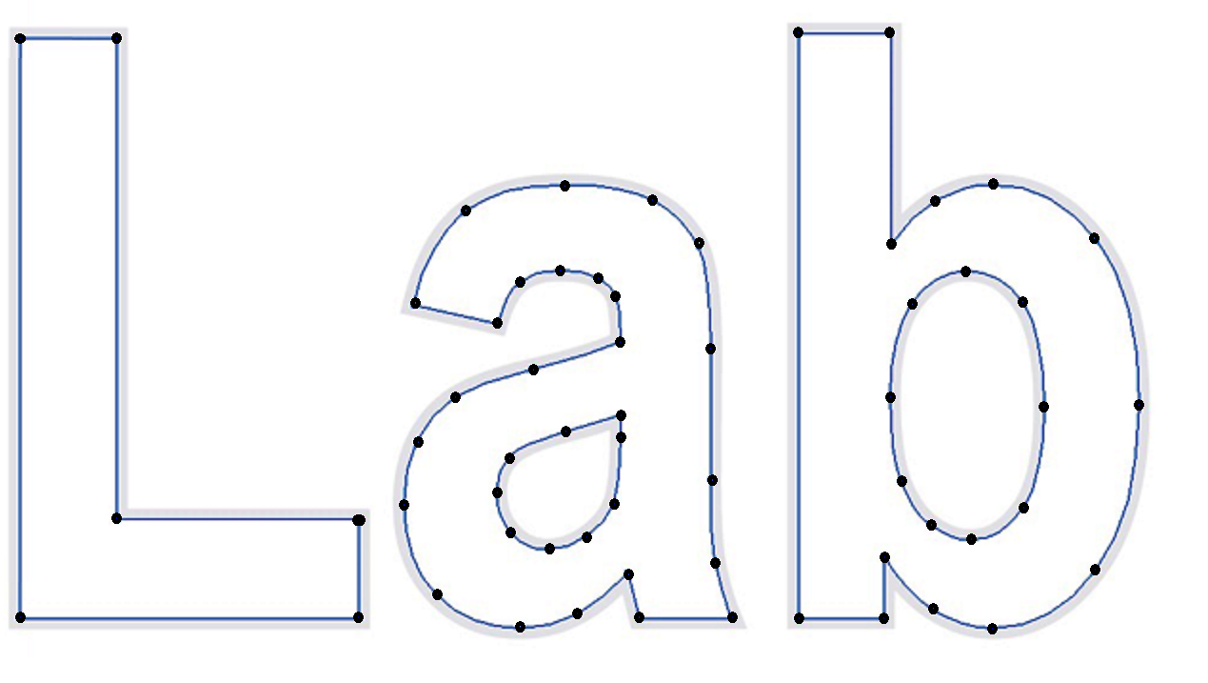
Bézier curves in “nature”

Slide 15
Mathematics of Bézier curves
Algebra:
interpolation
Geometry:
anchor points
control points
Computation:
De Casteljau’s algorithm
Calculus:
Tangent properties

Slide 16
Interpolation
assume two numbers, x₀ and x₁
the number in the middle is (50% of x₀) + (50% of x₁)
more general x(t) = ( 1-t ).x₀ + t.x₁
if t runs from 0 to 1 then we get all values x₀ ≤ x(t) ≤ x₁
think of t as a percentage of a path
e.g. having taken 33.3% of the path from x₀ to x₁ (on a number line)
x(0) = x₀
x(⅓)
x(⅔)
x₁= x(1)
Notes:
Object Reference variables will be dealt with in OOP lateron
Available simple types are determined by the language
Variable names can be freely chosen, give meaningful names!
Assigning a value in the variable declaration is optional… but…it is good practice to initialize variables

Slide 17
Interpolation in 2D
assume two points P₀ = (x₀,y₀) and P₁ = (x₁,y₁)
the point in the middle is (50% of P₀) + (50% of P₁)
more general P(t) = (1-t).P₀ + t.P₁
meaning P(t) = (x(t),y(t))
where x(t) = (1-t).x₀ + t.x₁
and y(t) = (1-t).y₀ + t.y₁
P(0) = P₀
t
P(⅓)
P(⅔)
P₁= P(1)
Notes:
Object Reference variables will be dealt with in OOP lateron
Available simple types are determined by the language
Variable names can be freely chosen, give meaningful names!
Assigning a value in the variable declaration is optional… but…it is good practice to initialize variables

Slide 18
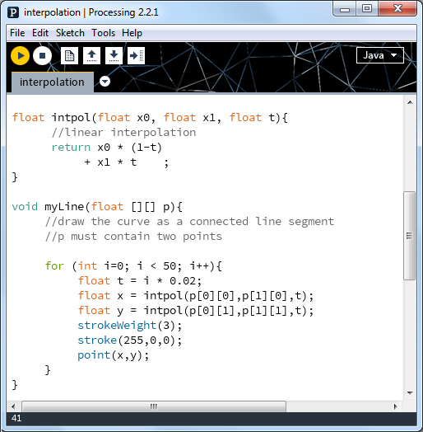

Slide 19
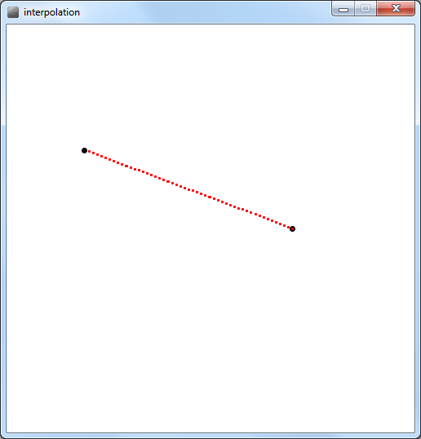

Slide 20
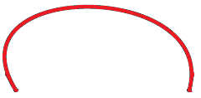
Anchor points and control points
one segment defined by 4 points
between P₀ and P₃, the parameter t runs from 0 to 1
the point P(t) is a weighted average of P₀,P₁,P₂,P₃
P = (1- t)³P₀ + 3(1- t)²t P₁ + 3(1- t)t²P₂ + t³P₃
P₁
P₂
P₀
P₃
Notes:
Object Reference variables will be dealt with in OOP lateron
Available simple types are determined by the language
Variable names can be freely chosen, give meaningful names!
Assigning a value in the variable declaration is optional… but…it is good practice to initialize variables

Slide 21
To be continued at the lightboard

Slide 22
Tangent properties

Slide 23
Example in Processing
Bézier polynomial

Slide 24
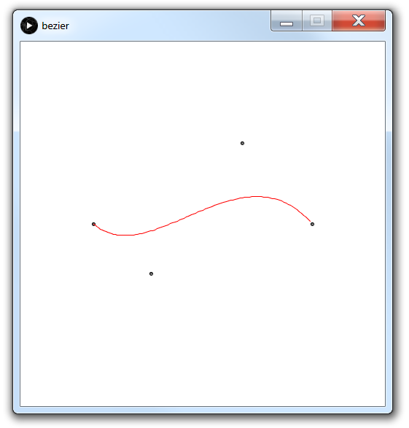

Slide 25
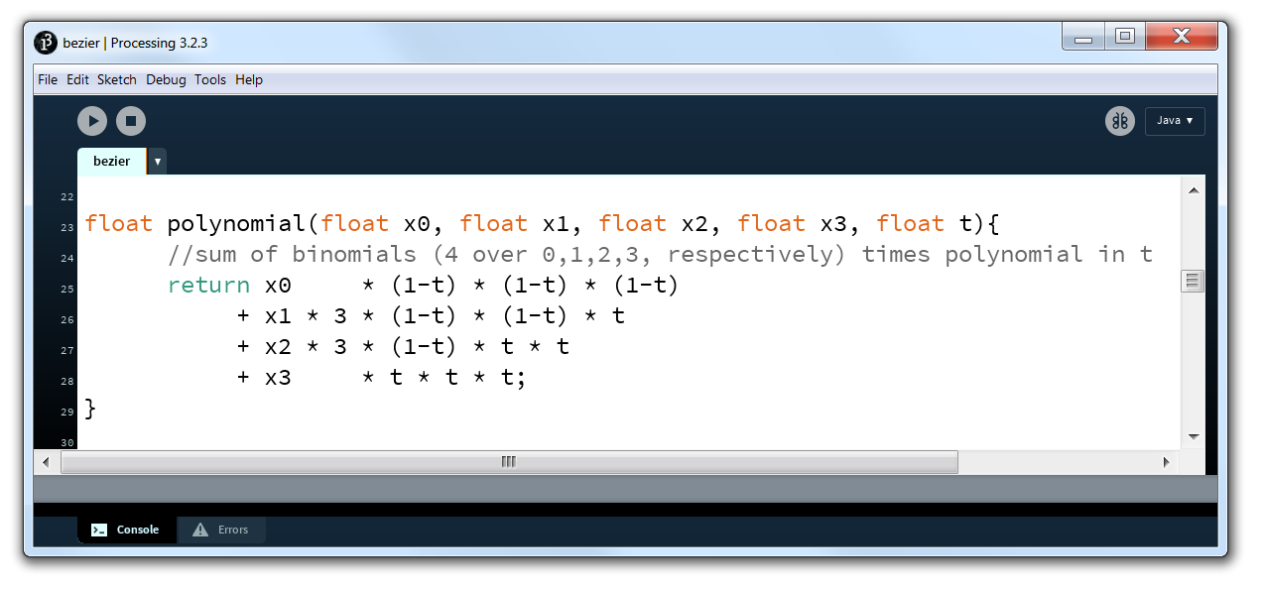

Slide 26
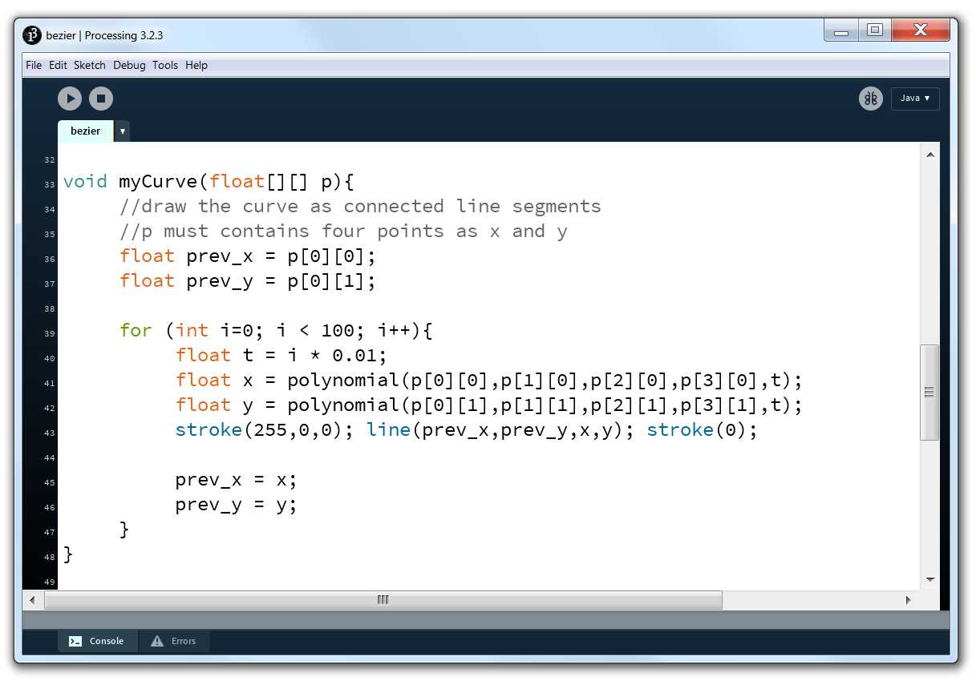

Slide 27
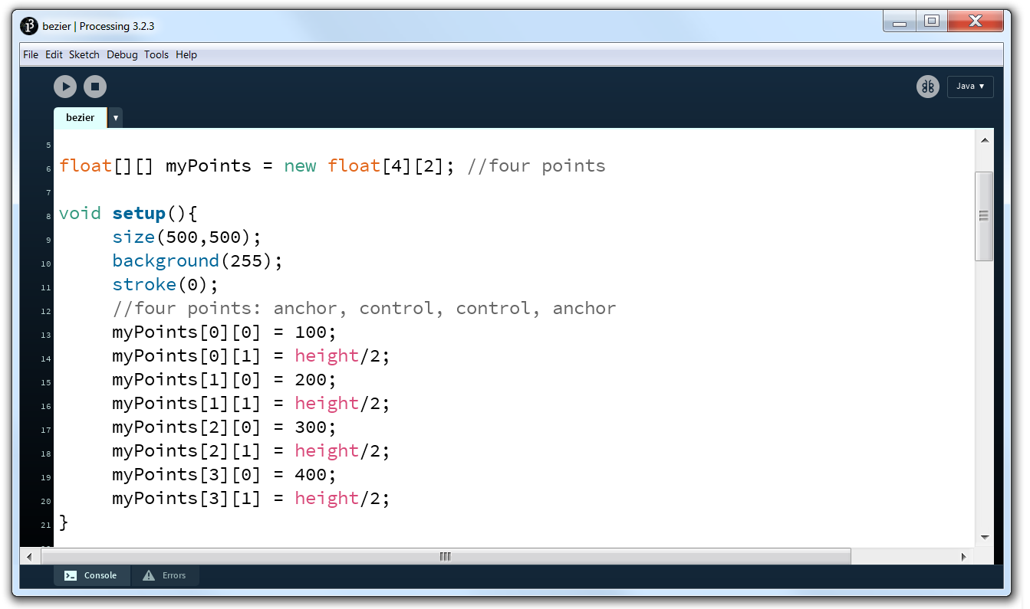

Slide 28
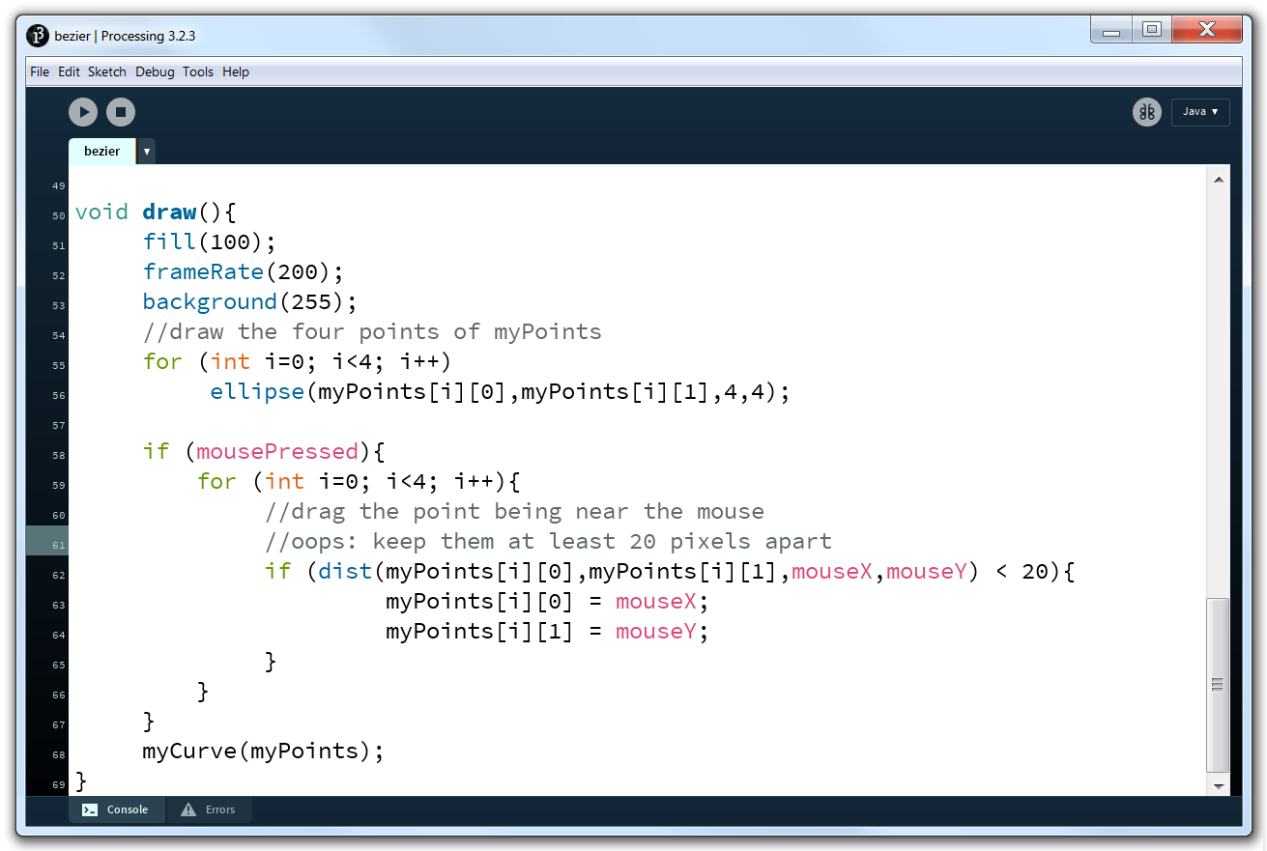

Slide 29
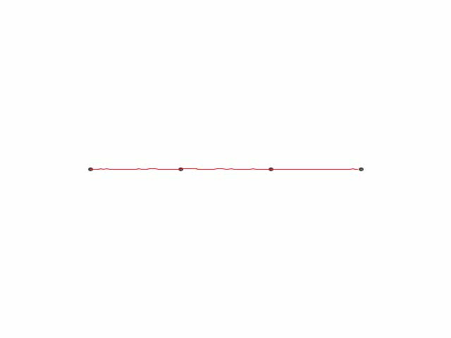

Slide 30
Recap and reflection
Bézier curve is just one example of “spline”
the formula is based on a simple polynomial
it empowers you to make your own CAD tools
programming principles:
polynomial coded in function
similar interpolation for x and y
approximate curve with for loop
drag and drop anchors, control points
dynamic typography: one more example

Slide 31


Slide 32
